Slide 1

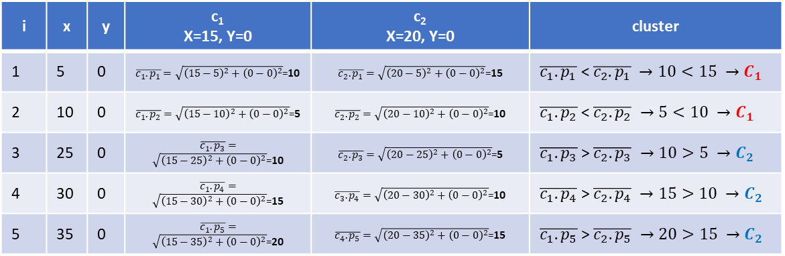
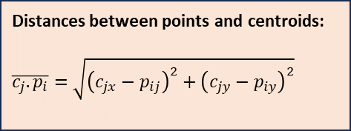
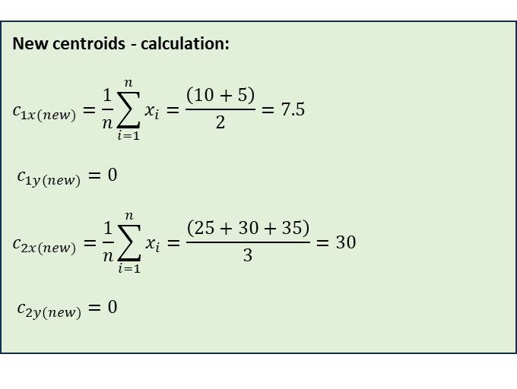
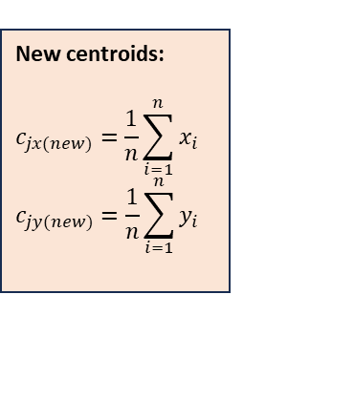
© 2024, Martin Bilek
https://englishwithmartin.com
martin.bilek48@gmail.com
K-means case study:
Distances between points and centroids:
$$\overline{c_{j}.p_{i}}=\sqrt{{\left(c_{jx}−p_{ij}\right)}^{2}+{\left(c_{jy}−p_{iy}\right)}^{2}}$$
y
New centroids:
$$c_{jx(new)}=\frac{1}{n}\sum_{i=1}^{n}{x_{i}}$$
$$c_{jy(new)}=\frac{1}{n}\sum_{i=1}^{n}{y_{i}}$$
C_{1(new)}=7.5
C_{2(new)}=30
P₁=5
P₂=10
C₁=15
C₂=20
P₃=25
P₄=30
P₅=35
x
New centroids - calculation:
$$c_{1x(new)}=\frac{1}{n}\sum_{i=1}^{n}{x_{i}}=\frac{\left(10+5\right)}{2}=7.5$$
$c_{1y(new)}=0$
$$c_{2x(new)}=\frac{1}{n}\sum_{i=1}^{n}{x_{i}}=\frac{\left(25+30+35\right)}{3}=30$$
$c_{2y(new)}=0$
i | x | y | c₁ X=15, Y=0 | c₂ X=20, Y=0 | cluster
1 | 5 | 0 | $\overline{c_{1}.p_{1}}=\sqrt{{\left(15−5\right)}^{2}+{\left(0−0\right)}^{2}}$=10 | $\overline{c_{2}.p_{1}}=\sqrt{{\left(20−5\right)}^{2}+{\left(0−0\right)}^{2}}$=15 | $\overline{c_{1}.p_{1}}$ < $\overline{c_{2}.p_{1}} →10<15 →C_{1}$
2 | 10 | 0 | $\overline{c_{1}.p_{2}}=\sqrt{{\left(15−10\right)}^{2}+{\left(0−0\right)}^{2}}$=5 | $\overline{c_{2}.p_{2}}=\sqrt{{\left(20−10\right)}^{2}+{\left(0−0\right)}^{2}}$=10 | $\overline{c_{1}.p_{2}}$ < $\overline{c_{2}.p_{2}} →5<10 →C_{1}$
3 | 25 | 0 | $\overline{c_{1}.p_{3}}=\sqrt{{\left(15−25\right)}^{2}+{\left(0−0\right)}^{2}}$=10 | $\overline{c_{2}.p_{3}}=\sqrt{{\left(20−25\right)}^{2}+{\left(0−0\right)}^{2}}$=5 | $\overline{c_{1}.p_{3}}$ > $\overline{c_{2}.p_{3}} →10>5 →C_{2}$
4 | 30 | 0 | $\overline{c_{1}.p_{4}}=\sqrt{{\left(15−30\right)}^{2}+{\left(0−0\right)}^{2}}$=15 | $\overline{c_{3}.p_{4}}=\sqrt{{\left(20−30\right)}^{2}+{\left(0−0\right)}^{2}}$=10 | $\overline{c_{1}.p_{4}}$ > $\overline{c_{2}.p_{4}} →15>10 →C_{2}$
5 | 35 | 0 | $\overline{c_{1}.p_{5}}=\sqrt{{\left(15−35\right)}^{2}+{\left(0−0\right)}^{2}}$=20 | $\overline{c_{4}.p_{5}}=\sqrt{{\left(20−35\right)}^{2}+{\left(0−0\right)}^{2}}$=15 | $\overline{c_{1}.p_{5}}$ > $\overline{c_{2}.p_{5}} →20>15 →C_{2}$

